Slide 1
A
Presentation
On
Web Technology Lab
Digital Dairy Farm Manager
Presented by
Harshwardhan Zalte [UCS23M1137]
Prasad Waghmode [UCS23M1131]
Tanmay Shinde [0124UCSM2014]
Rohan Walke [UCS23M1133]
Department of Computer Engineering
TY B Tech 2025-26 SEM V

Slide 2
Client Details
Client Name - Samadhan Trayambak Hasale.
Occupation - Farmer and Dairy Business.
3. Address - Mirgaon , Tal : Sinner , Dist : Nashik , Maharashtra 422104
*
DEPARTMENT OF COMPUTER ENGINEERING, Sanjivani COE, Kopargaon
2

Slide 3
Client Requirements
The Client is a Dairy Business Owner.
Dairy Farm Manager who needs a system to digitally manage daily dairy operations and reduce manual record-keeping.
*
DEPARTMENT OF COMPUTER ENGINEERING, Sanjivani COE, Kopargaon
3

Slide 4
Functional Requirement
Customer Management: Maintain customer profiles with name, milk type (Cow/Buffalo), daily milk quantity, contact number, and address.
Milk Collection Management: Record daily milk collection from farmers, including quantity, fat %, quality testing results, and purchase rate per litre.
Milk Supply Tracking (Internal Distribution): Track daily milk allocation/supply to customers, local shops, hotels, or distributors (only recording, no delivery system).
Inventory & Stock Management: Track stock of milk, packaging materials, starter culture, and dairy products such as curd, paneer, ghee, butter, etc.
Farmer/Vendor Management: Manage farmer details, milk supply logs, rates, and monthly milk purchase summary.
Report Generation: Generate daily/weekly/monthly reports for milk collection, milk supplied, and inventory usage.
*
DEPARTMENT OF COMPUTER ENGINEERING, Sanjivani COE, Kopargaon
4

Slide 5
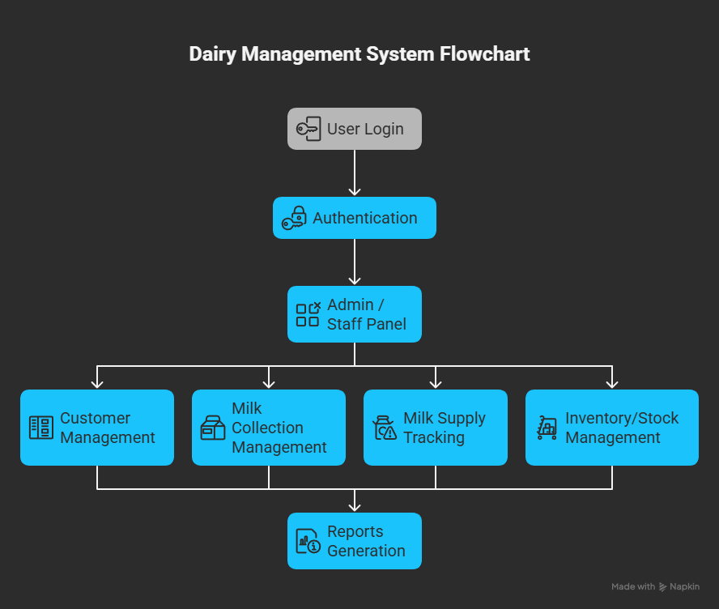
System Flow
*
DEPARTMENT OF COMPUTER ENGINEERING, Sanjivani COE, Kopargaon
5

Slide 6
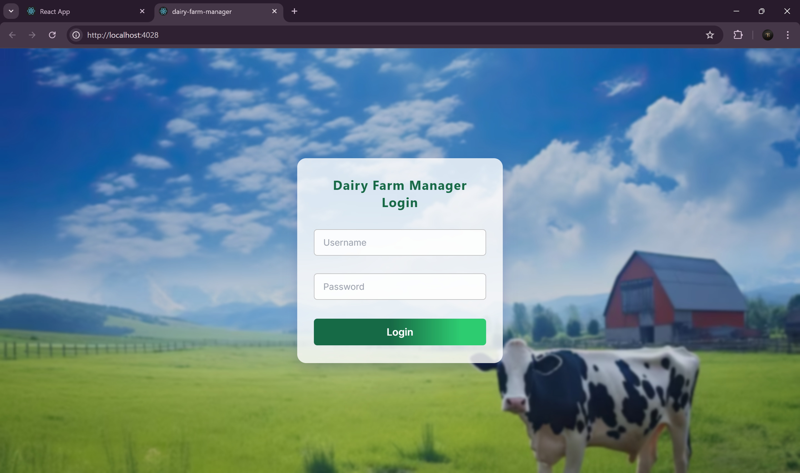
Login Page
*
DEPARTMENT OF COMPUTER ENGINEERING, Sanjivani COE, Kopargaon
6

Slide 7
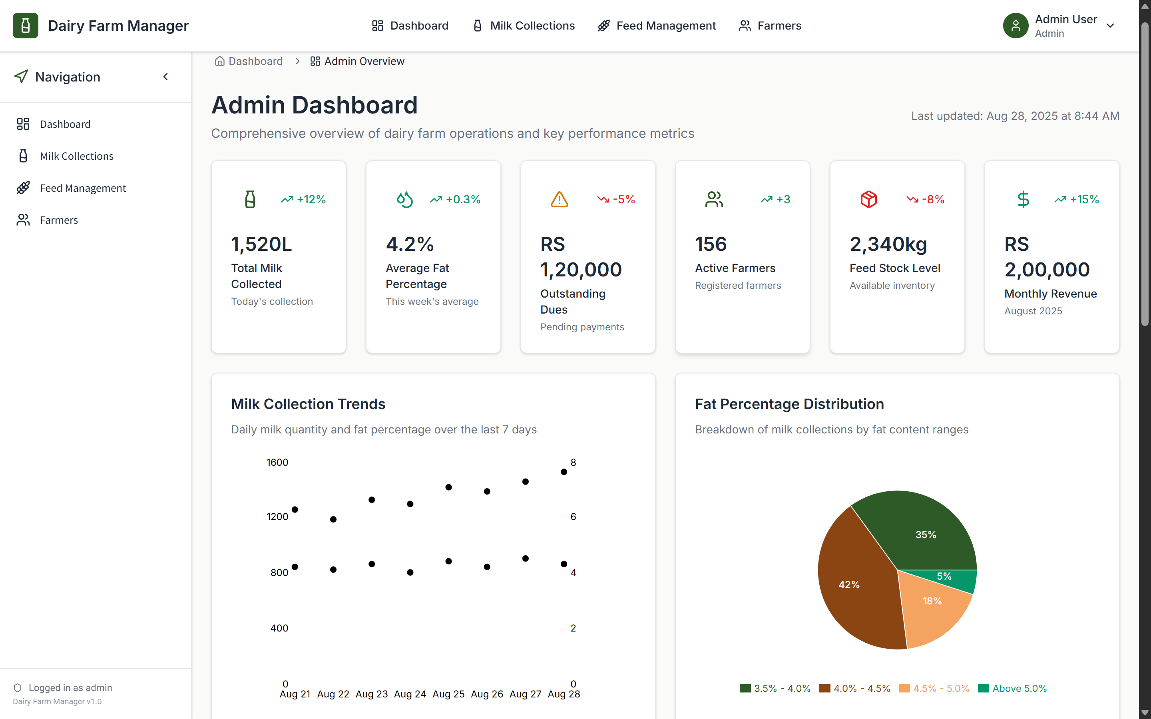
Admin Dashboard
*
DEPARTMENT OF COMPUTER ENGINEERING, Sanjivani COE, Kopargaon
7

Slide 8
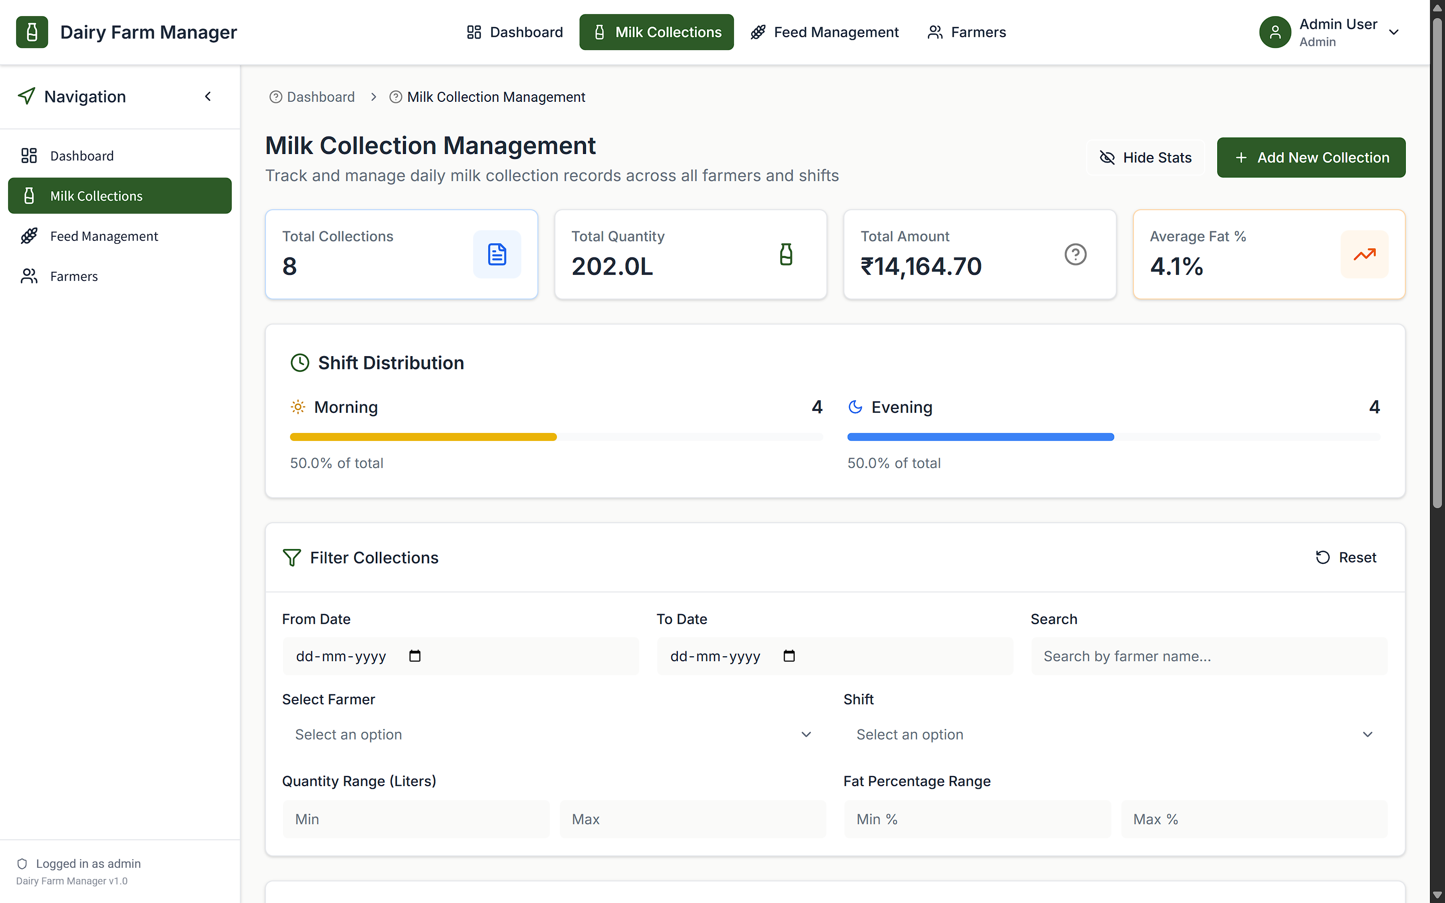
Milk Collection Management
*
DEPARTMENT OF COMPUTER ENGINEERING, Sanjivani COE, Kopargaon
8

Slide 9
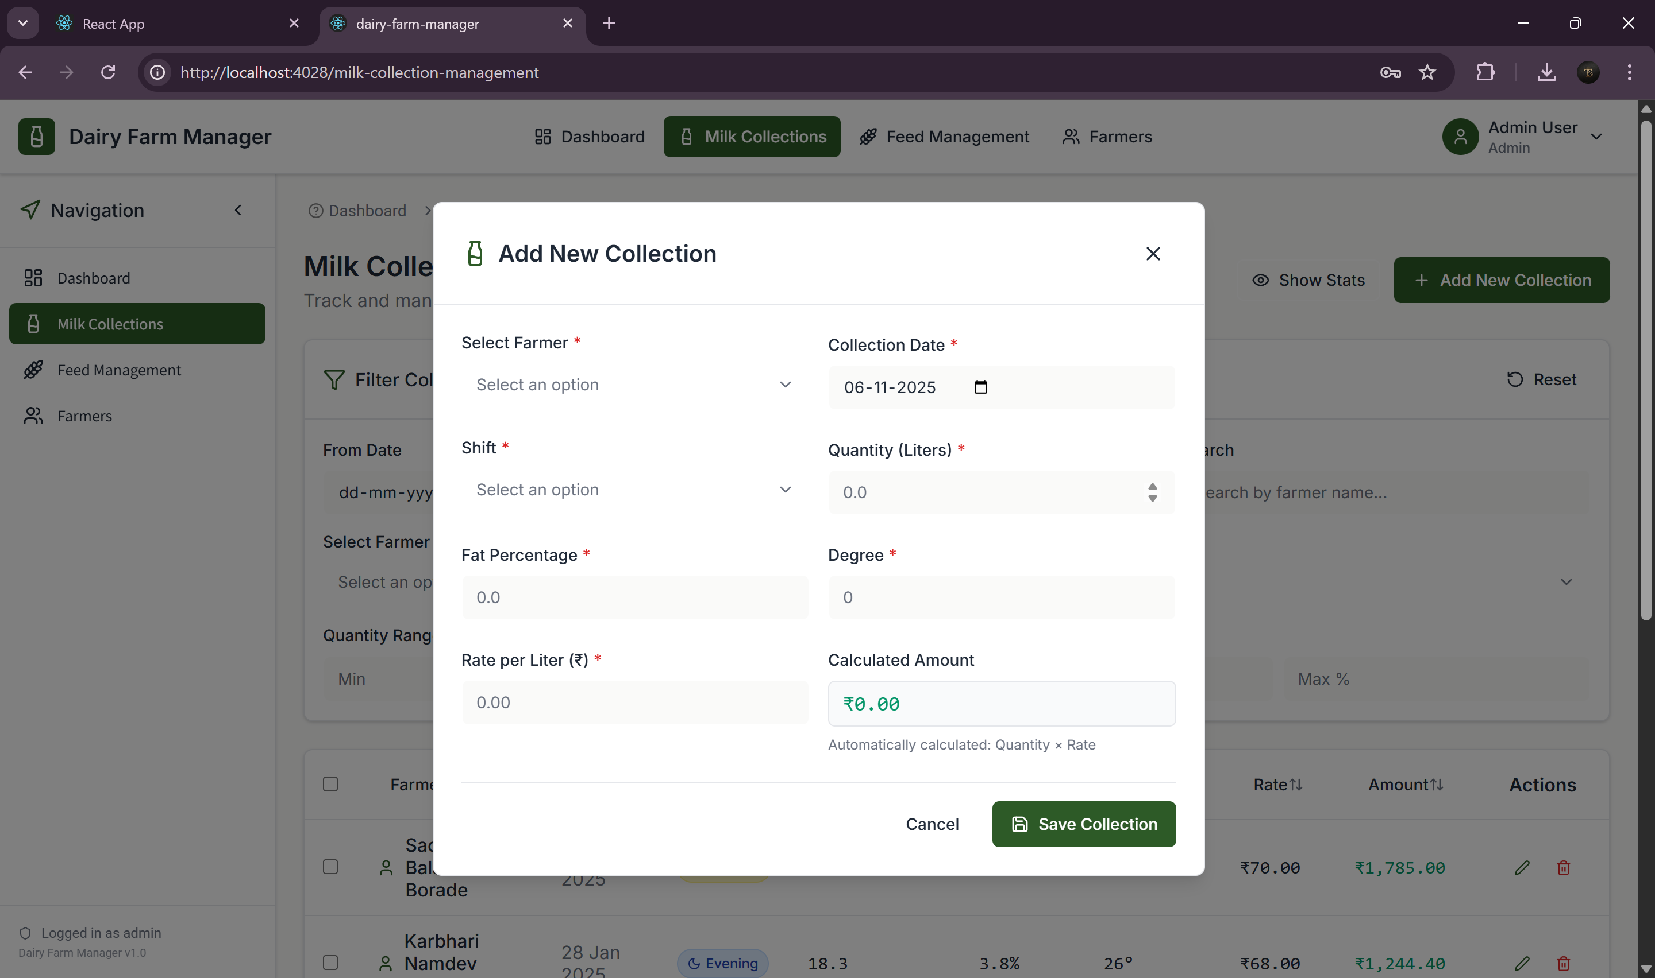
*
DEPARTMENT OF COMPUTER ENGINEERING, Sanjivani COE, Kopargaon
9

Slide 10
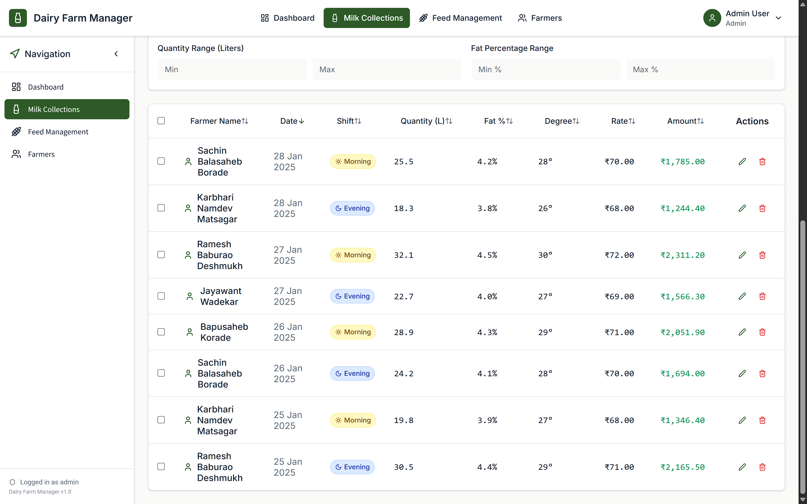
*
DEPARTMENT OF COMPUTER ENGINEERING, Sanjivani COE, Kopargaon
10

Slide 11
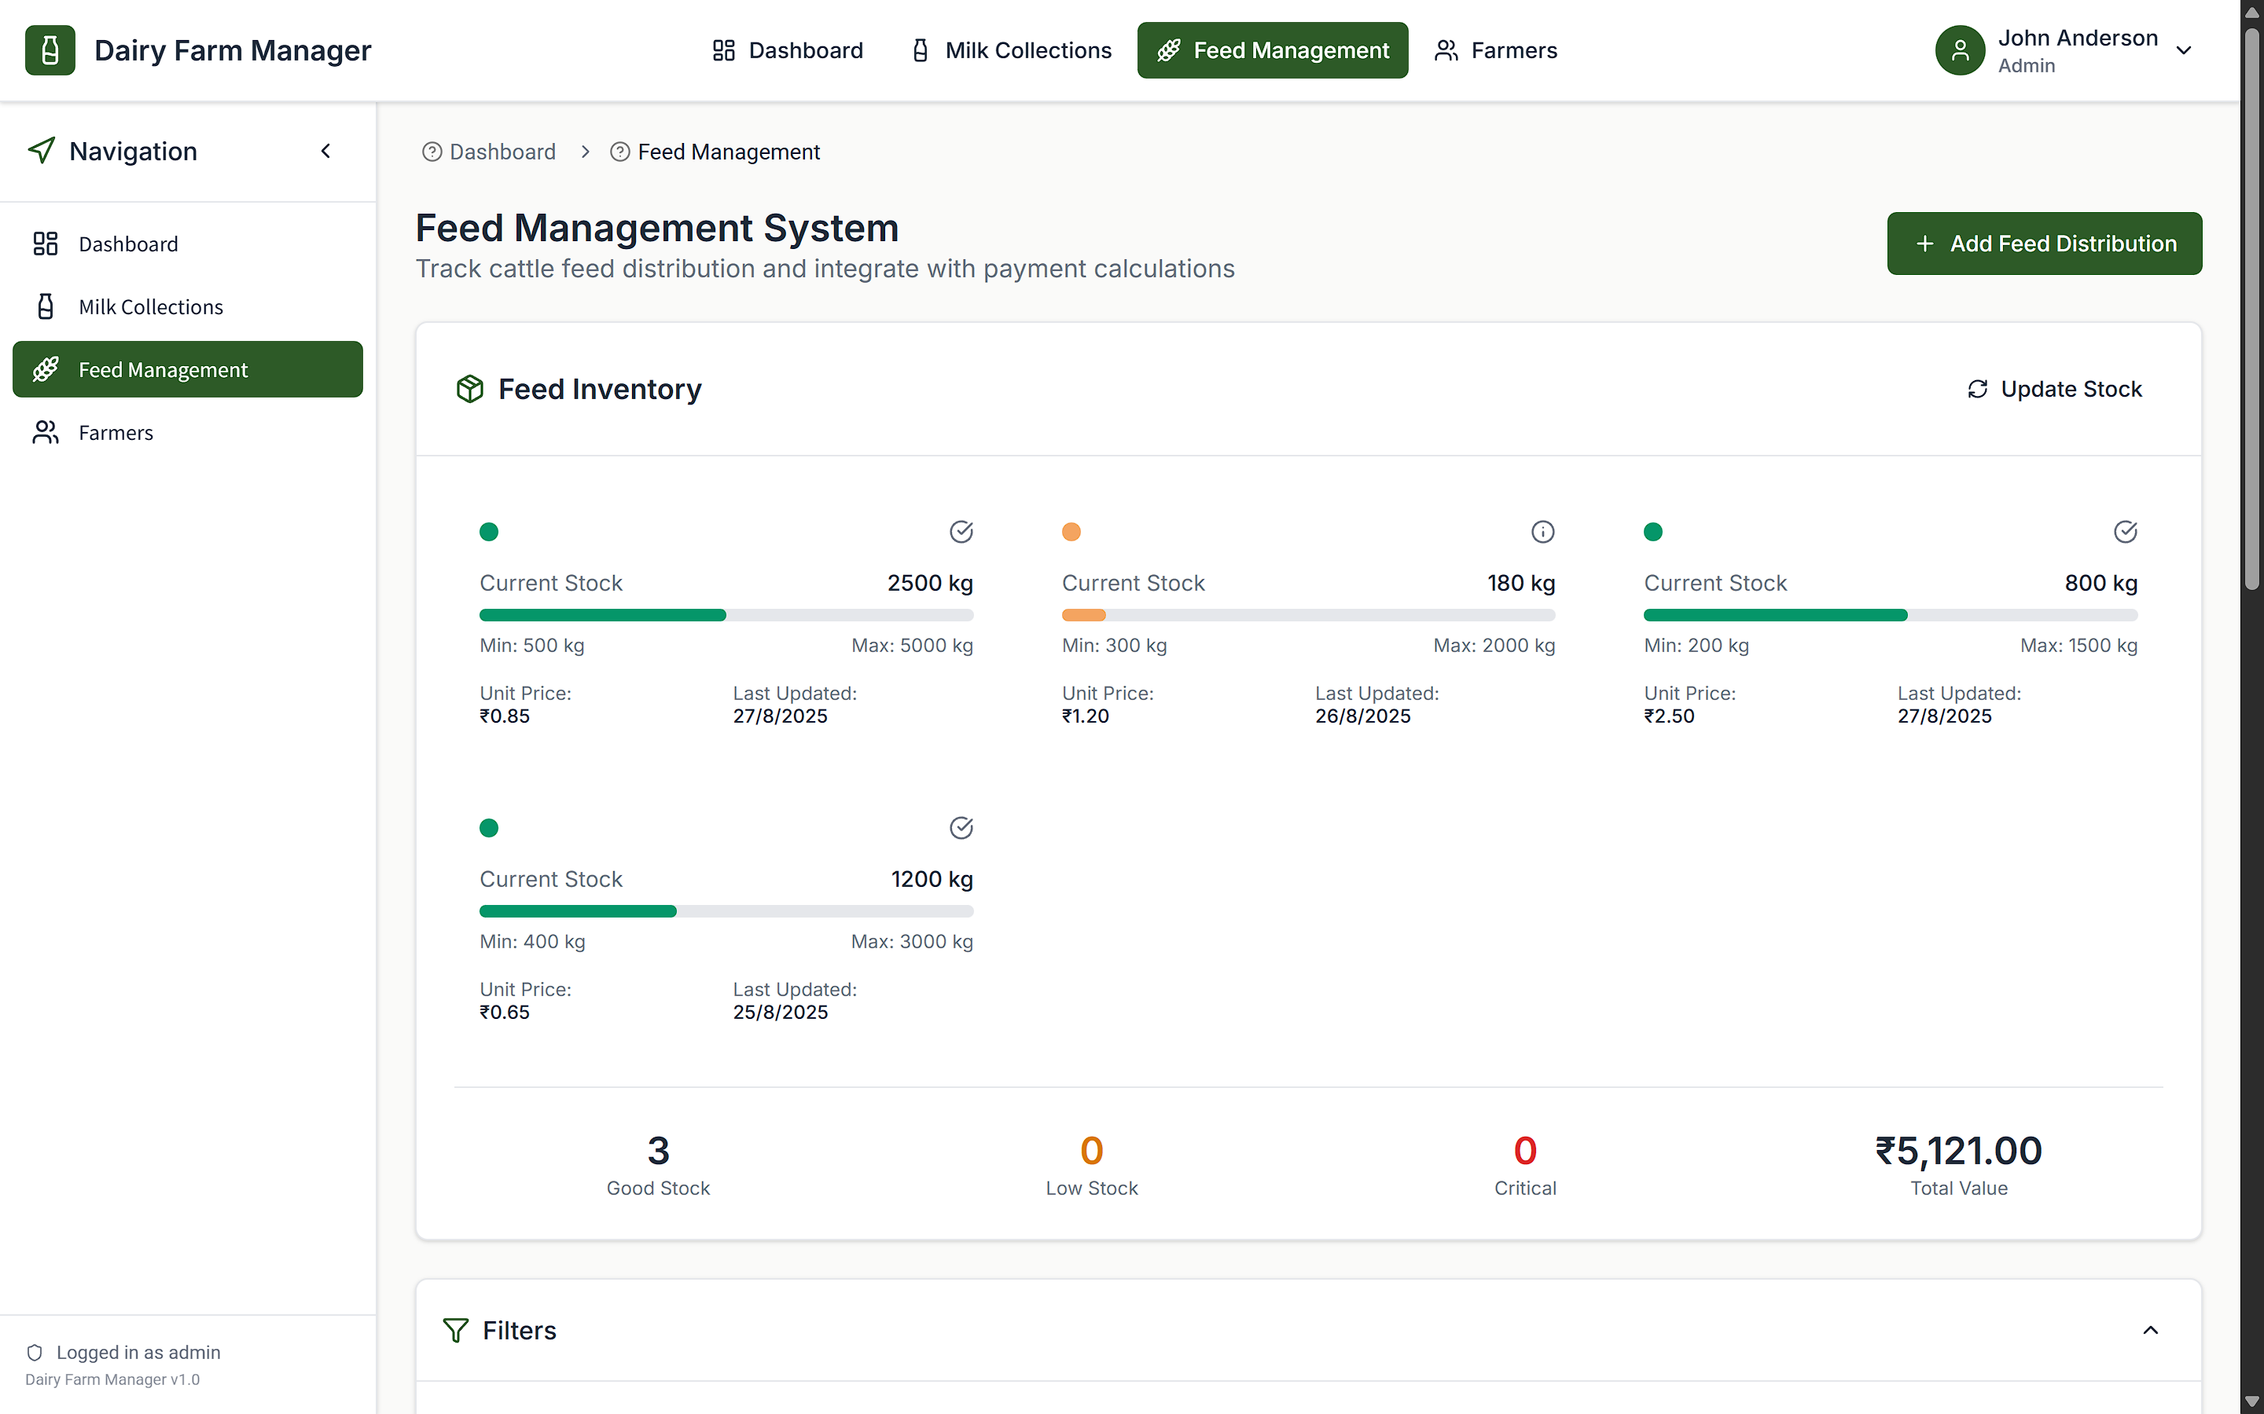
Feed Management System
*
DEPARTMENT OF COMPUTER ENGINEERING, Sanjivani COE, Kopargaon
11

Slide 12
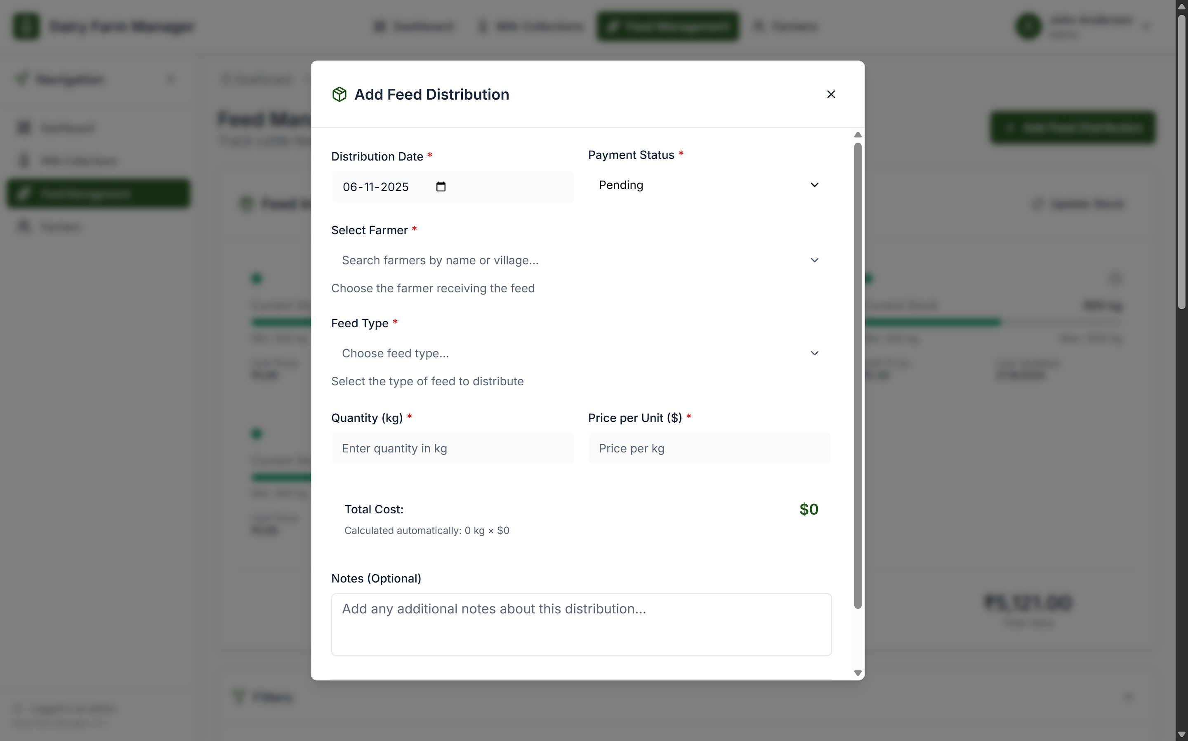
*
DEPARTMENT OF COMPUTER ENGINEERING, Sanjivani COE, Kopargaon
12

Slide 13
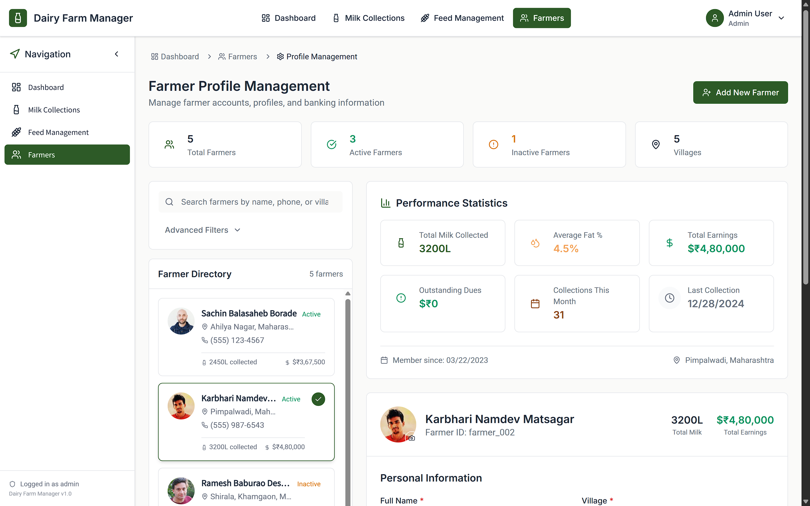
Farmer Profile Management
*
DEPARTMENT OF COMPUTER ENGINEERING, Sanjivani COE, Kopargaon
13

Slide 14
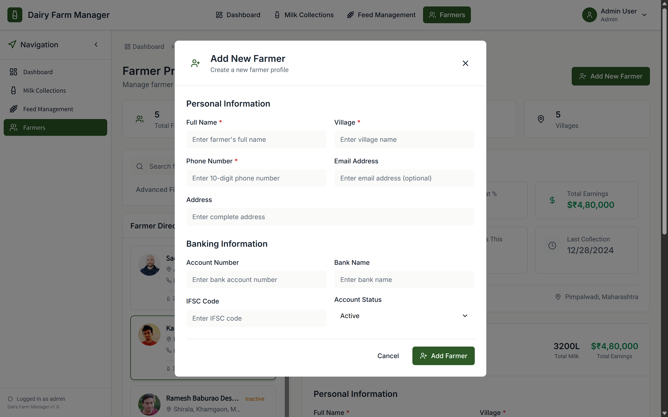
*
DEPARTMENT OF COMPUTER ENGINEERING, Sanjivani COE, Kopargaon
14

Slide 15
FrontEnd Technology Used
HTML5: Provides page structure for forms, tables, dashboards, and registration screens.
CSS3 / Bootstrap: Used for responsive UI design to ensure a clean layout on mobile and desktop.
JavaScript: Adds interactivity, form validations, and dynamic updating of data on screens.
React.js: Used to build a more interactive and real-time dashboard for admin and staff.
*
DEPARTMENT OF COMPUTER ENGINEERING, Sanjivani COE, Kopargaon
15

Slide 16
Frontend Key Features
Responsive design supporting mobile & desktop.
Validation for customer, farmer, and milk record entries.
Dashboard with summary cards (Daily Milk In, Milk Out, Stock Balance).
Charts for graphical representation of monthly milk collection & supply trends
*
DEPARTMENT OF COMPUTER ENGINEERING, Sanjivani COE, Kopargaon
16

Slide 17
Backend Technology Used
Node.js with Express.js: Handles server logic, API endpoints, authentication, and communication with the database.
MySQL: Database for storing customer, farmer, milk records, stock, and reports.
RESTful APIs: Allows smooth data exchange between frontend and backend.
JWT Authentication: Secures user login and role-based access (Admin/Staff).
*
DEPARTMENT OF COMPUTER ENGINEERING, Sanjivani COE, Kopargaon
17

Slide 18
Backend Functionality
CRUD operations for customer, farmer, and stock records.
Validate and store milk collection and supply data.
Generate reports from stored data.
Protect API routes using role-based authentication.
*
DEPARTMENT OF COMPUTER ENGINEERING, Sanjivani COE, Kopargaon
18

Slide 19
Conclusion
*
DEPARTMENT OF COMPUTER ENGINEERING, Sanjivani COE, Kopargaon
19

Slide 20
THANK YOU
*
DEPARTMENT OF COMPUTER ENGINEERING, Sanjivani COE, Kopargaon
20

